Slide 1


Slide 2

Questions about second/third class?

Slide 3
Class 2 - 3 - Review
Two new commands to work with the remote repository git pull, git status
To show which data type a variable uses, we use type()
Strings are sequences, we could split sequence using and print it using print(str[_:_])
A bit on import sys module and how to use methods available in the module
Exercises on arithmetic operations
Introduction on how to make decisions using python
While loop(infinite loop, finite loop)
Basics on fluxograms applied to programming
Basic analysis on how to make functions (prepare piece of code to be a function)
Update code in files located in the remote repository

Slide 4
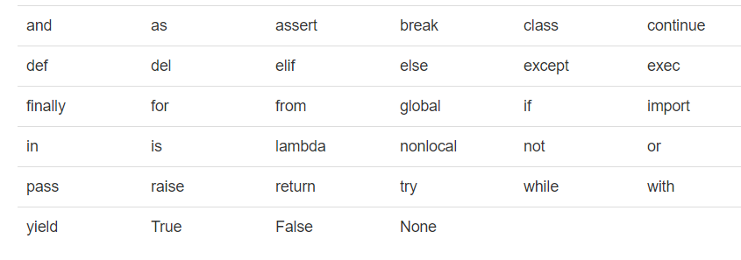
Python Reserved Words
Already knew words
New words
Near future words
Other future words

Slide 5
Simple For Loop
5
4
3
2
1
Boom!!
Yes
Done?
No
Move i ahead
for i in [5, 4, 3, 2, 1] :
print(i)
print(‘Boom!!')
print(i)
print(‘Boom!')

Slide 6
For loop with Strings
Congrats on your new job: Ana Congrats on your new job: Filipe
Congrats on your new job: João
Done!
friends = [‘Ana’, ‘Filipe', ‘João']
for friend in friends :
print(‘Congrats on your new job:', friend)
print('Done!')

Slide 7
in word
No
Yes
Done?
Move i ahead
Five-element sequence
Iteration variable
print(i)
for i in [5, 4, 3, 2, 1] :
print(i)
The iteration variable “iterates” through the sequence (ordered set)
The block (body) of code is executed once for each value in the sequence
The iteration variable moves through all of the values in the sequence

Slide 8
range word
https://docs.python.org/3/library/stdtypes.html#typesseq-range
for name in range(max):
statements
Repeats for values 0 (inclusive) to max (exclusive)
Before
0
1
2
3
4
After
print('Before')
for i in range(5):
print(i)
print('After')

Slide 9
More ranges
for name in range(min, max):
statements
for name in range(min, max, step):
statements
Can specify a minimum other than 0, and a step other than 1
After
2
3
4
5
Before
print('Before')
for i in range(2, 6):
print(i)
print('After')
print('Before')
for i in range(15, 0, -5):
print(i)
print('After')
Before
15
10
5
After

Slide 10
How to make a loop
1
2
for thing in data:
3
Set some variables to initial values
Look for something or do something to each entry separately, updating a variable
Look at the variables

Slide 11
Looping examples
print('Before')
for thing in [9, 41, 12, 3, 74, 15] :
print(thing)
print('After')
Before
9
41
12
3
74
15
After

Slide 12

<WELCOME >
<Exercise – 1-2>

Slide 13
<Exercise 1>
1 - Write a code to print out the capital letters in a string:
The Best of made in Portugal – Hats, Soaps, Shoes,Tiles & Ceramics, Cork
Expected input: The Best of made in Portugal – Hats, Soaps, Shoes,Tiles & Ceramics, Cork
Expected output: TBPHSSTCC

Slide 14
<Exercise 2>
2 - Write a code to print numbers from 0 – 50 divisible by 4
Consider 0 in your code
Expected output:
0
4
8
12
16
20
24
28
32
36
40
44
48

Slide 15
Loop to find the largest number
Before -1
9 9
41 41
41 12
41 3
74 74
74 15
After 74
largest_so_far = -1
print('Before', largest_so_far)
for the_num in [9, 41, 12, 3, 74, 15] :
if the_num > largest_so_far :
largest_so_far = the_num
print(largest_so_far, the_num)
print('After', largest_so_far)

Slide 16
Loop to count
Before 0
1 9
2 41
3 12
4 3
5 74
6 15
After 6
loop_interaction = 0
print('Before', loop_interaction )
for thing in [9, 41, 12, 3, 74, 15] :
loop_interaction = loop_interaction + 1
print(loop_interaction , thing)
print('After', loop_interaction )

Slide 17
Loops to sum
sum = 0
print('Before’, sum)
for thing in [9, 41, 12, 3, 74, 15] :
sum = sum + thing
print(sum, thing)
print('After’, sum)
Before 0
9 9
50 41
62 12
65 3
139 74
154 15
After 154

Slide 18
Loop to find the average value
Before 0 0
1 9 9
2 50 41
3 62 12
4 65 3
5 139 74
6 154 15
After 6 154 25.666
count = 0
sum = 0
print('Before', count, sum)
for value in [9, 41, 12, 3, 74, 15] :
count = count + 1
sum = sum + value
print(count, sum, value)
average_value = sum / count
print('After', count, sum, average_value)

Slide 19
Loop to select values
print('Before')
for value in [9, 41, 12, 3, 74, 15] :
if value > 20:
print('Large number',value)
print('After')
Before
Large number 41
Large number 74
After

Slide 20
Loop to search using boolean
Before False
False 9
False 41
False 12
True 3
True 74
True 15
After True
found = False
print('Before', found)
for value in [9, 41, 12, 3, 74, 15] :
if value == 3 :
found = True
print(found, value)
print('After', found)

Slide 21
Loop to find the smallest value
smallest = None
print('Before')
for value in [9, 41, 12, 3, 74, 15] :
if smallest is None :
smallest = value
elif value < smallest :
smallest = value
print(smallest, value)
print('After', smallest)
Before
9 9
9 41
9 12
3 3
3 74
3 15
After 3

Slide 22
is and is not Operators
smallest = None
print('Before')
for value in [3, 41, 12, 9, 74, 15] :
if smallest is None :
smallest = value
elif value < smallest :
smallest = value
print(smallest, value)
print('After', smallest)
Python has an is operator that can be used in logical expressions
is not also is a logical operator

Slide 23


